Slide 1

UCB DATA ANALYTICS BOOTCAMP - PROJECT 1 /TEAM 7 GRANT ITOW
JEAN VICENCIO NAVEEN CHAKICHERLA ROSE MARY RIOS RYAN PONTICELLI
Notes:
Proposal:
the condition of being sound mentally and emotionally that is characterized by the absence of mental illness and by adequate adjustment especially as reflected in feeling comfortable about oneself, positive feelings about others, and the ability to meet the demands of daily life also : the general condition of one’s mental and emotional state
Mental Health (def.) : Definition of MENTAL ILLNESS : https://www.merriam-webster.com/dictionary/noun
any of a broad range of medical conditions (such as major depression, schizophrenia, obsessive-compulsive disorder, or panic disorder) that are marked primarily by sufficient disorganization of personality, mind, or emotions to impair normal psychological functioning and… See the full definition
Definition of NOUN: https://www.merriam-webster.com/dictionary/mental%20illness
any member of a class of words that typically can be combined with determiners to serve as the subject of a verb, can be interpreted as singular or plural, can be replaced with a pronoun, and refer to an entity, quality, state, action, or concept… See the full definition
Goal:
Objective:

Slide 2

Disclaimer: Data gathered and conclusions enclosed are intended for research only and makes no judgement/stance on the challenges individuals experience that negatively impact their mental health.
Topic Overview (including data source) (1 min)
Team Presentations (10 min)
Major Key FIndings & Conclusions (2 min)
Q&A (2 min)
Notes:
PROJECT 1 - Presentation/Guide: ( remember visualizations should have the same format- colors, font type/size)
Topic Overview: xxxxxx (1 min)
Topic Objective
Data set used
Major findings with details to introduced by our team:
Q. (1 min)
Q. (1 min)
Q. (1 min)
Q. (1 min)
Conclusion / Summary of each section :(1 min)
x
x
x
Thank You / Questions

Slide 3
Mental Health Data Analysis
Objectives:
Compare mental health correlation between different groups/ attributes (e.g., self-employed vs. employed individuals, different countries, gender, etc) to identify disparities or similarities and their potential causes and provide insights that could inform public health policies, interventions, or initiatives aimed at improving mental health outcomes at local, national, or global levels.
Data: Survey Results (https://www.kaggle.com/datasets/bhavikjikadara/mental-health-dataset/data)
Mental health is defined based on factors and symptoms negatively affecting an individual’s mental well being.
Features:
Mental Health Candidacy = Family history + treatment + mental health history + growing stress + changes_habits
Mental Health Severity = coping_struggles + mood_swings + work_interest + social_weakness
Methodology:
Convert categorical values to numeric values
Data clean up: Remove blanks and remove time stamp
create relevant data frames for specific analysis
Notes:
survey results = one-time, not time-bound
Candidacy Rating: Expected to represent how individuals are rated based on their candidacy criteria, possibly indicating propensity to mental health issues. e.g. where higher values indicate a higher propensity to experience mental health issues. Candidacy rating is the sum of value(s)* for unique columns in a given row.
Mental Health Severity: Expected to represent the severity of mental health conditions, where higher values indicate more severe conditions.
df_candidacy = pd.DataFrame()df_candidacy['candidacy'] = (df_factors['family_history'] +
df_factors['treatment'] +
df_factors['growing_stress'] +
df_factors['changes_habits'] +
df_factors['mental_health_history'])
# Calculate unique severity DataFrame from candidacy
df_severity = pd.DataFrame()
df_severity['severity'] = df_factors['coping_struggles'] +
df_factors['mood_swings'] +
df_factors['work_interest'] +
df_factors['social_weakness'])'''

Slide 4
Questions & Hypothesis
Questions:
Does Gender play a significant role in mental health?
Does one’s chosen occupation play a significant role in mental health?
Does job fulfillment have a positive impact on one’s mental health?
Does being “self-employed” make you more or less susceptible to mental health issues?
Does the prevalence of mental health issues differ between countries?
How impactful is family history on mental health?
Hypothesis (one or more plus descriptions)
Females have a higher chance of having a history of mental health.
People in corporate occupations have a higher likelihood of reporting a history of mental health issues.
Mental health can have a positive/negative impact on a person's work interest.
Self-employment has a positive impact on mental health
Countries outside the United States will have increased prevalence of mental health issues.
A Family History of mental health increases the probability of seeking treatment.

Slide 5
Question 1: Does Gender play a significant role in mental health?
Null Hypothesis: Gender does not affect mental health wellness
Alternative Hypothesis: Females have a higher chance of having a history of mental health.
Explanation: Gender vs. Mental Health History by means of self-reported survey.

Slide 6
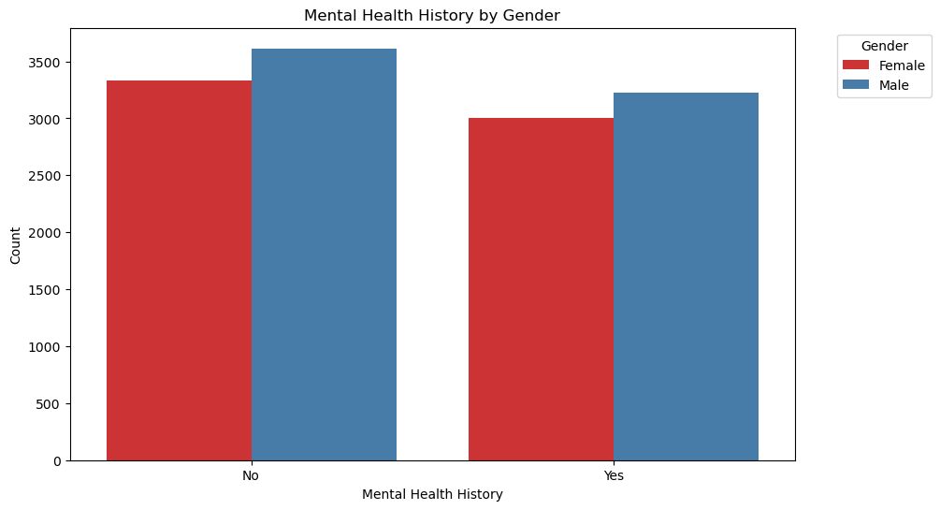
Question 1: Gender vs. Mental Health History
Bar plot to visualize counts of Mental Health History by Gender:
A count plot is created to show the distribution of mental health history by gender.
Visualization demonstrates “Yes” and “No” responses to “Mental Health History” question on self-reported survey.
Data is sorted by Gender - “Male” and “Female.”

Slide 7
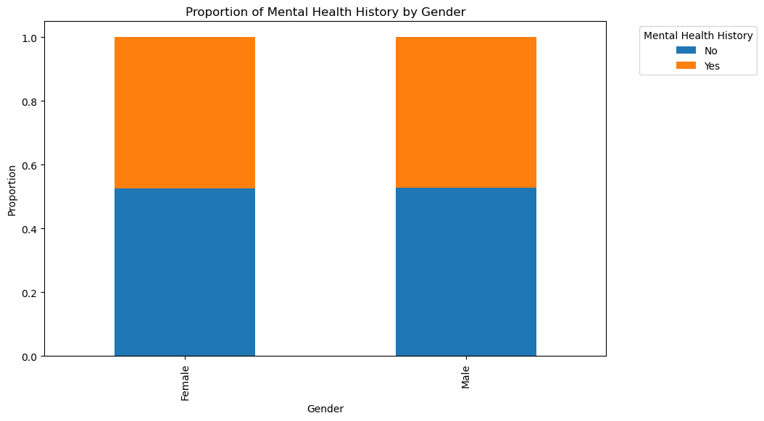
Question 1: Gender vs. Mental Health History
A stacked bar plot to visualize these proportions:
Within each bar, different colored segments represent the proportions of “Yes” and “No” responses for mental health history.
Data again, is sorted by Gender - “Male” and “Female.”
By comparing the segments within each bar, you can see the relative proportion of individuals with and without a history of mental health issues within each gender.

Slide 8
Question 1: Gender vs. Mental Health History
Conclusion:
The Chi-Squared test helps to statistically determine if there is a significant association between occupation and mental health history. Based on the p-value, it is concluded whether or not such an association exists.
This comprehensive analysis helps in understanding how mental health history varies across the different genders and whether these variations are statistically significant.
A p-value of 1.0 strongly supports the null hypothesis, indicating that there is no evidence of a relationship between gender and mental health history based on sample study. These results suggest that any observed differences in mental health history between genders are due to random chance or other factors.

Slide 9
Question 2 : Does one’s chosen occupation play a significant role in mental health?
Null Hypothesis: Occupation does not affect mental health wellness
Alternative Hypothesis: People in corporate occupations have a higher likelihood of reporting a history of mental health issues.

Slide 10
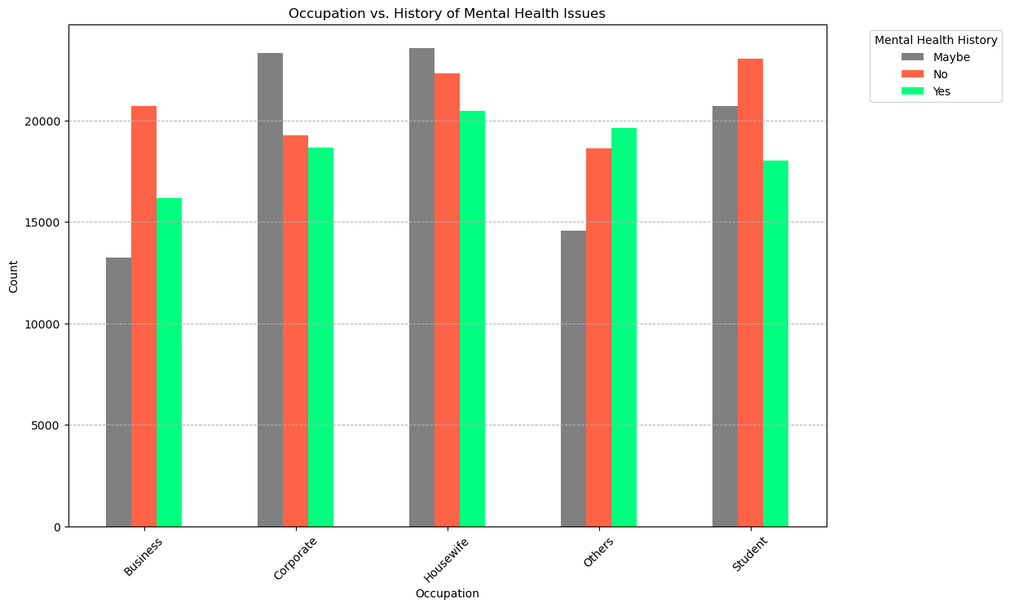
Question 2: Occupation vs. Mental Health History
Bar plot to visualize counts of Mental Health History by Occupation:
The code groups the data by Occupation and Mental Health History.
Data is sorted by “Occupation” and self-reported survey with the values of “Yes”, “No’ and “Maybe.”
The “Maybe” response was included in final data to add further variability.

Slide 11
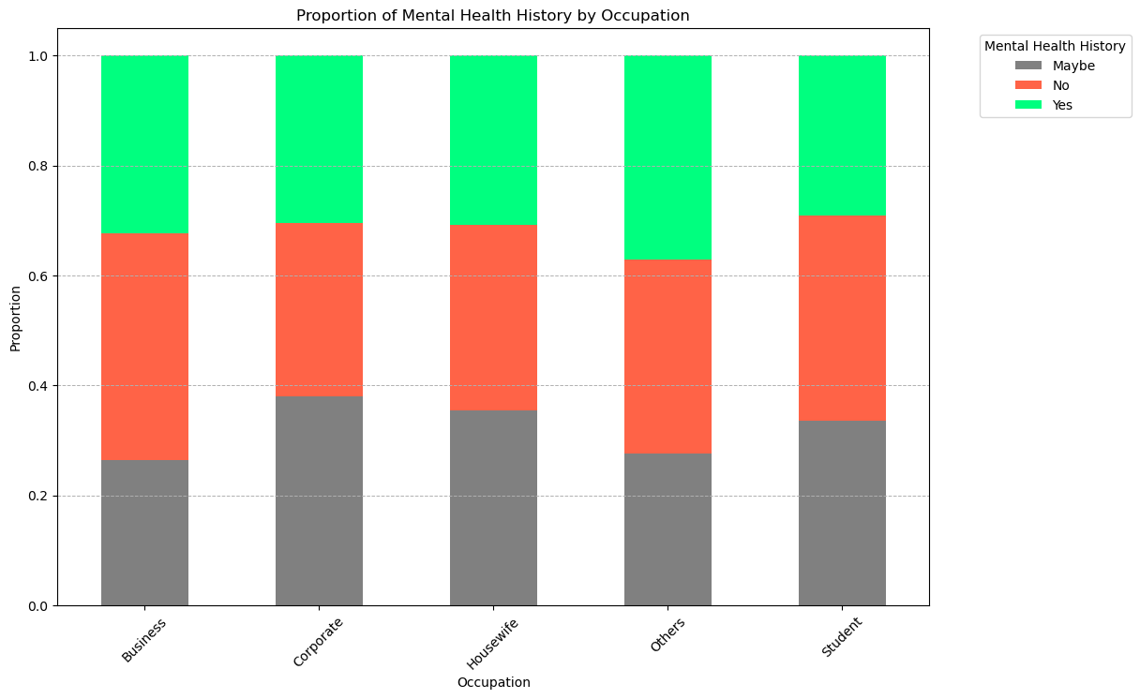
Question 1: Occupation vs. Mental Health History
A stacked bar plot to visualize these proportions:
Within each bar, different colored segments represent the proportions of “Yes”, “No” and “Maybe” responses for mental health history.
Data was collected from a self-reported survey.
By comparing the segments within each bar, this demonstrates the relative proportion of individuals with and without a history of mental health issues within each occupation.

Slide 12
Question 2: Occupation vs. Mental Health History
Conclusion:
The Chi-Squared test helps to statistically determine if there is a significant association between occupation and mental health history.
This comprehensive analysis helps in understanding how mental health history varies across different occupations and whether these variations are statistically significant.
Chi-Squared test determined a value > 0.05, which indicates no significant association between Occupation and Mental Health.
These results suggest that any observed differences in mental health history between occupations are due to random chance or other factors.

Slide 13
Question 3: Does mental health factors have an impact on one’s interest in their work?
Null Hypothesis: Ones Mental Health state does not affect a person interest in their work.
Alternative Hypothesis: The lower the severity of a person's Mental Health challenges positively correlates with higher work interest, and a lower Candidacy of mental health history also positively correlates with work interest.
Notes:
Greetings folks - lets take a look @ “DOes tjo

Slide 14
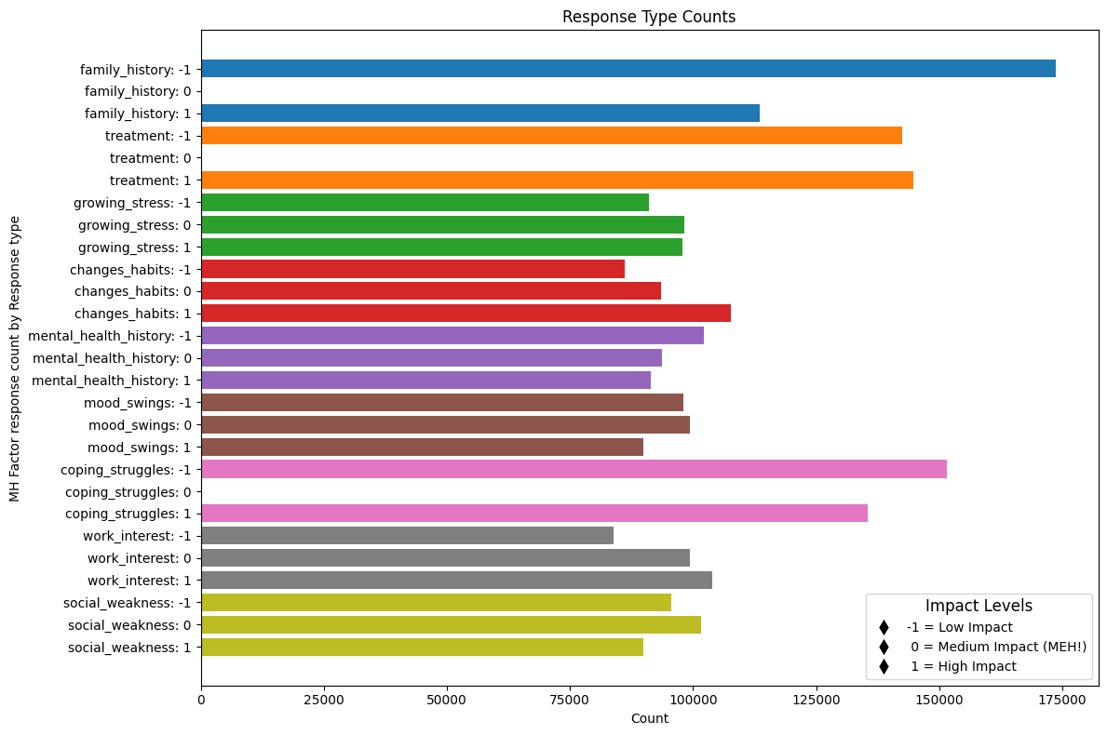
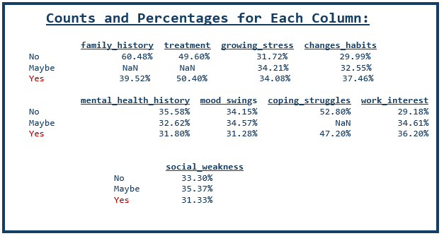
Question 3 - Mental Health Responses Comparisons
Visual look at the landscape of those surveyed across multiple factors →
Impact Distribution
Responses are centric to “0: (Medium Impact), indicating a balanced view of mental health factors.
Low Impact (-1)
Infrequently reported, suggesting minimal negative influence on mental health.
Medium Impact (0)
Most common response, reflecting moderate perceptions across factors.
High Impact (1)
Less common, indicating select factors are seen to significantly affect mental health.
Variability in Responses:
There is data variability in responses (e.g., undisclosed mental health history, evenly spread of mood swings responses) where response options included a MAYBE option.
While the data reflects respondents responses are clustered in the middle with no extremes the data equally showcases the responses do not have large variances. The data cannot measure if respondents are forthcoming and is further showcased where Maybe response counts is relatively chosen just as much as a definitive Yes or No.
Notes:
Approach: Showcase the broader (MACRO)population data, to look at the MICRO level ( Work Interest and its impacting factors base upon the surveyed responses.
The broader view of response breakdown across key data points can be seen visually but at a detailed view we can see the % spans.
<review slide points>
Insights
Distribution:
Responses tend to cluster around 0 (Medium Impact), indicating a moderate stance across various MH factors.
Impact Levels:
There are fewer extreme responses (-1 and 1) compared to moderate responses (0), suggesting a tendency towards neutral or moderate views across the factors.
Comparative Analysis:
The chart allows for easy comparison of response distributions across different MH factors in a single view.
Visualization:
Bars are labeled to indicate the MH factor and the corresponding response type (-1, 0, 1), providing clear insights into how each factor is perceived in terms of impact.

Slide 15
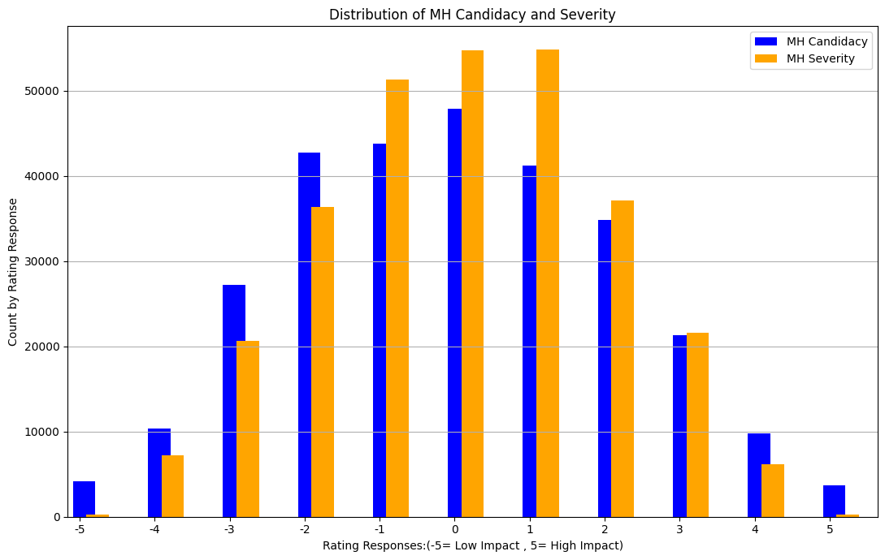
Question 3 - Mental Health Candidacy vs. Mental Health Severity Ratings
(Def.) Two new data features for Ratings are derived data points for the aggregation of a respondents responses for columns capturing data regarding their history ( candidacy of mental health impacts) and experiences currently being encountered (severity of the mental health impacts)
Comparing the Aggregations
Distribution Shape: Most responses cluster around ratings like -1, 0, and 1 for both Candidacy and Severity. Very few people rated things as extreme highs (5) or lows (-5).
Comparison on Low Impact Ratings: Severity ratings have more -3, -2, and -1 ratings compared to Candidacy, which suggests people report more serious mental health issues in these ranges than state they have a history with mental health impacts.
Neutral to Positive Ratings: Candidacy ratings spread out more evenly around neutral (0) and slightly positive (1, 2), while Severity tends to stick closer to neutral.
Rare Extreme Ratings: There are hardly any responses at the extremes (-5 and 5) in either dataset, showing that extreme opinions on mental health issues are pretty uncommon.
Implication of Responses: People generally lean towards neutral or slightly negative impacts, and there aren't many extreme views in either dataset.
Although at the micro level there were outlier results when only a Yes or No were response options, this macro aggregation is pointing to the same result : Respondents responses are clustered in the middle. HOWEVER this showcases more visibility to variance between the two metrics ( candidacy vs MH severity( (-3, -2, -1, 0, and 1) . Further research may be needed to discern if this is due to the MAYBE response option availability in two candidacy factors where MH Severity only had one factor. (hhhmm?)
COnclusion : Candidacy ratings are more evenly spread out, while severity ratings tend to spike towards more neutral. Respondents may be less inclined to be forthcoming about hier MH history versus sharing their current negative MH experiences.
Features:
Mental Health Candidacy = Family history + treatment + mental health history + growing stress + changes_habits
Mental Health Severity = coping_struggles + mood_swings + work_interest + social_weakness
Notes:
Distribution Shape & Comparison
Candidacy:
Middle Ratings: Peaks at -1, 0, 1.
Extreme Ratings: Decline towards -5 and 5.
Implication: Responses cluster around neutral or moderate ratings, with few extreme opinions.
Severity:
Dual Peaks: Peaks at neutral (0, 1) and slightly negative (-1).
Implication: More frequent moderate severity reports, leaning towards neutral or slightly negative responses.
Comparison:
Negative Ratings:
Moderately Negative: Higher responses for MH Severity at -3, -2, -1 compared to Candidacy.
Implication: Indicates greater reported severity of mental health issues in these ranges.
Neutral to Positive Ratings:
Distribution: MH Candidacy responses are more evenly spread around neutral (0) and slightly positive (1, 2) than MH Severity.
Implication: Candidacy shows a wider range of opinions, while severity tends to be concentrated around neutral.
Extreme Ratings:
Extreme Values: Few responses at -5 and 5 for both datasets.
Implication: Indicates rarity of extreme views on both candidacy and severity.
Visual Insights:
1. Alignment: Blue (MH Candidacy) and orange (MH Severity) bars are adjacent.
o Implication: Facilitates direct visual comparison by rating.
2. Magnitude Difference: Notably higher counts for MH Severity in moderately negative ratings (-2, -1).
o Implication: Highlights greater concern/reporting on mental health severity in these ranges.
3. Symmetry: Candidacy is more symmetrically distributed around 0, while Severity skews towards negative.
o Implication: Candidacy ratings are evenly distributed, whereas severity ratings are biased towards negative or neutral.
Simplified Explanation of the Script:
1. Index Setting:
o Sets CandidacyRating and MentalHealthSeverity as row labels for easy plotting.
2. Plot Both:
o Plots both datasets on the same bar graph for direct comparison.
3. X-Axis Labels:
o Ensures labels from -5 to 5 are shown on the x-axis for clarity.

Slide 16
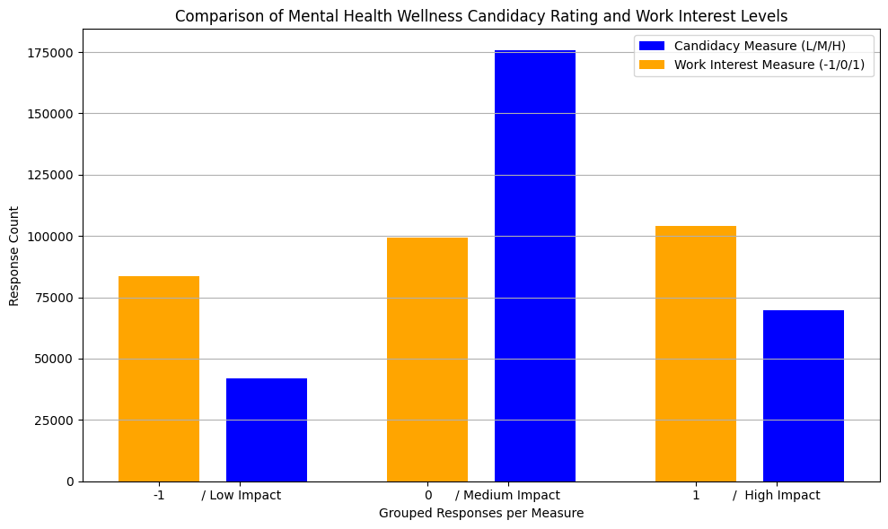
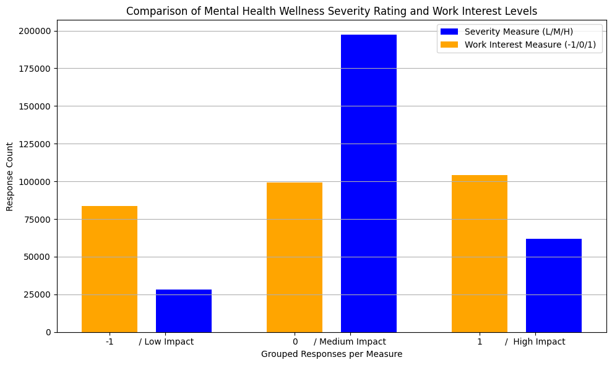
Question 3 - Mental Health Candidacy & MH Severity Rating to Work Interest Factor
Note: Data Scrubbing performed : Work Interest results had 3 unique responses captured where MH Severity had a range of 11 unique responses.
Candidacy and MH Severity Data:
The distributions shows more responses in the middle range (0 to 1) with a spike at 0 for both ratings.
Lower (-5 to -2) and higher values (2 to 5) have a some relative similar correlation for both ratings.
Work Interest Data:
Values are evenly spread across responses.
The work medium impact does NOT align with candidacy and MH severity.
Potential Correlation:
Comparing other all bins reveals a trends of variances between the ratings and work interest wi the great variance at the mid point.
The candidacy rating measure showcases if respondents have a low , medium or high propensity of being impacted to mental health issues.
The Work Interest measure showcases if respondents had a low , medium or high interest in their work .
Based up the comparative data the low and high end impacts the showcase more respondents having an relatively equal variance between their propensity to mental health issues vs the candidacy and MH severity ratings.

Slide 17
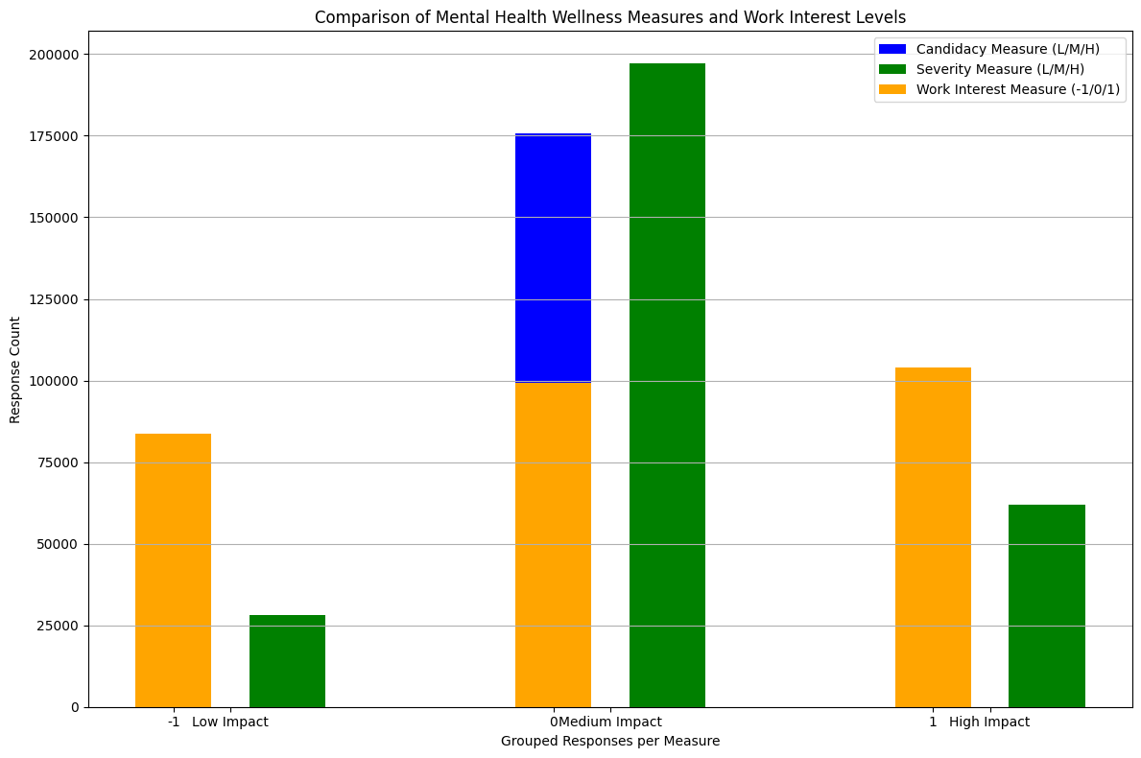
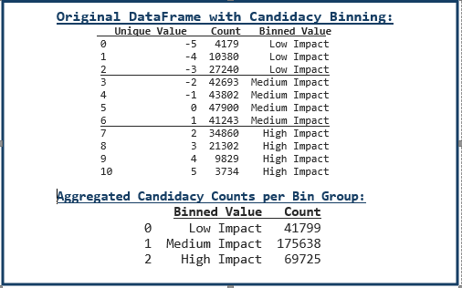
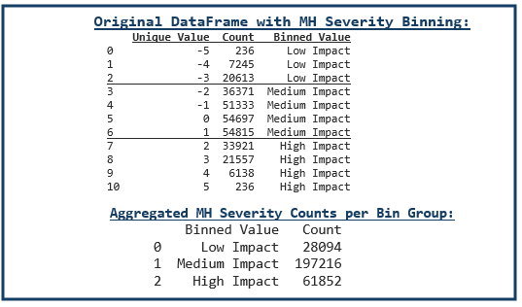
Question 3 - Combined MHealth Severity & Candidacy Rating to Work Interest ( Ratings Binning Details included)
Candidacy and MH Health Data & Work Interest COrrelation ( single view) :
The distributions shows a large volume of responses in the middle range (0 to 1) with a spike at 0 for both candidates ratings, while work interest ratings remain evenly spread amongst its ratings BUT the count variance is present across the ranges.

Slide 18
Question 3: Is there a relationship between MH wellness severity and candidacy ratings with work interest.
Question: Does job fulfillment have a positive impact on one’s mental health?
Null Hypothesis: Mental Health is not a factor to a person interest in work
Alternative Hypothesis: People that have a higher candidacy and experience a more experiences negatively impacting their mental health affects their interest in work.
Conclusion: Accept Null Hypothesis, reject Alternative Hypothesis
A large volume of respondents showcased a mid range raying for a propensity to mental health issues while also being negatively impacted by mental health issues and the volume of people's interest in work was evenly spread across the low/mid and high impact ratings

Slide 19
Question 4 : Are self-employed less susceptible to mental health?
Null Hypothesis: Employment status, whether self employed or not,does not affect mental health well-being
Alternative Hypothesis: Self-employed is less susceptible to mental health

Slide 20
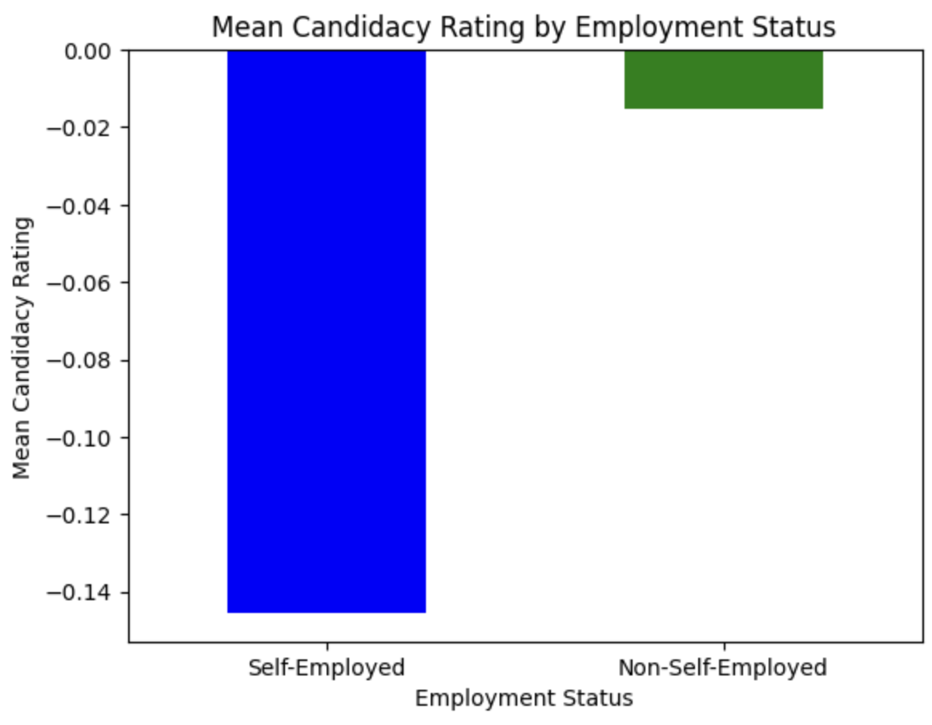
Question 4: Mental Health Candidacy Rating for Self Employment Status
Mean for self-employed: -0.0153 Mean for non self-employed: -0.1456
Self-employed has a mean mental health candidacy score of -0.0153, which is significantly higher (less negative) compared to non-self-employed individuals, who have a mean of -0.1456.
Self-employed, on average, exhibit lower susceptibility to mental health issues as measured by mental health history, family history, treatment, growing stress and changes habits

Slide 21
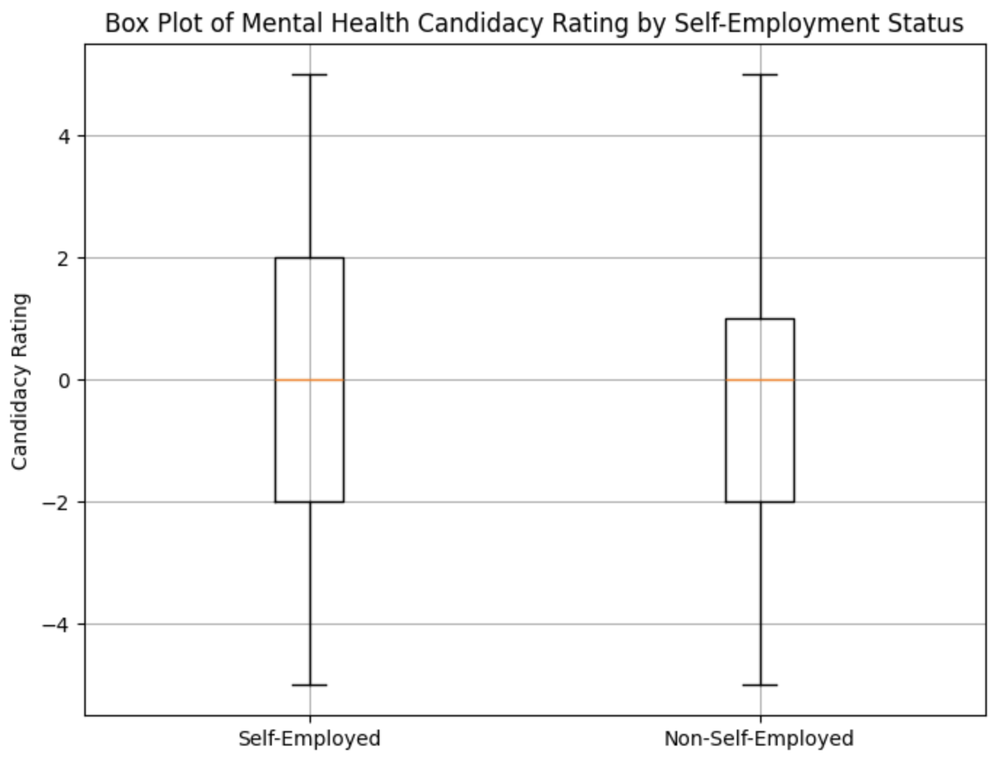
Question 4: Mental Health Candidacy Rating for Self Employment Status
t-statistic: 4.240901405180638
p-value: 2.236240127762111e-05
Degrees of Freedom: 19998
Reject null hypothesis
Based on the significant t-statistic and very low p-value, there is strong evidence to support the alternative hypothesis that self-employed individuals are less susceptible to mental health compared to non self-employed individuals based on identified factors

Slide 22
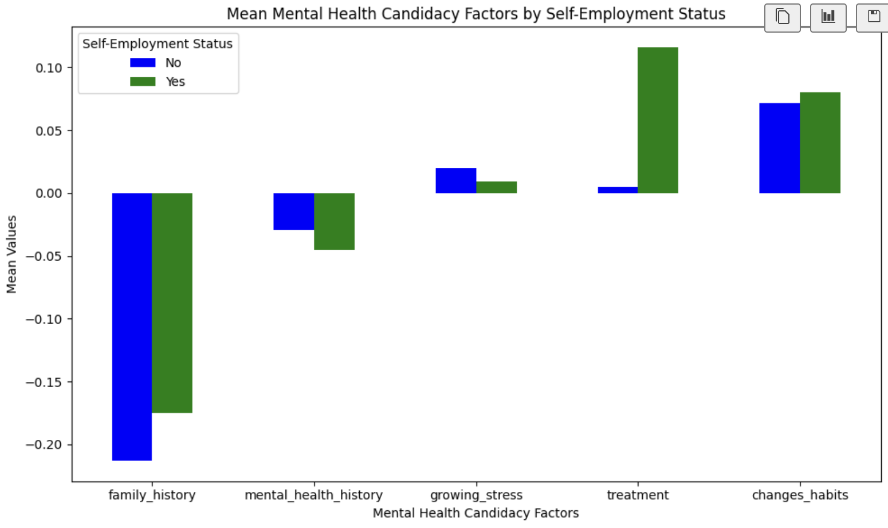
Question 4: Mental Health Candidacy Rating for Self Employment Status
Family History: Non-self employed, on average, may have slightly lower prevalence of family history related to mental health
Mental Health History: Self-employed, on average, may have a lower personal history of mental health issues compared to non-self employed individuals
Growing Stress: Self-employed seems to have slightly lower growing stress on average compared to non self-employed
Treatment: self employed are more likely to seek or receive treatment for mental health issues compared to non self employed
Changes in Habits: self-employed may exhibit slightly more changes in habits compared to non self employed

Slide 23
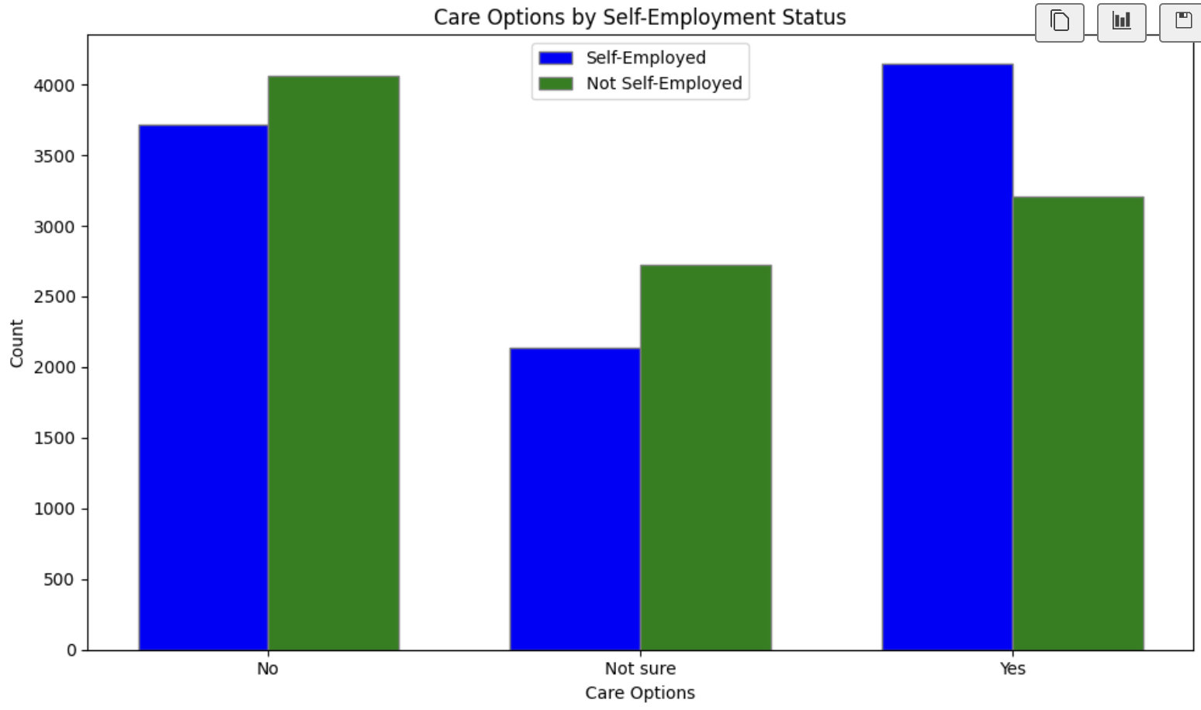
Question 4: Mental Health Candidacy Rating for Self Employment Status
Self-employed has a higher likelihood of having care options available compared to non-self-employed who are more likely to be unsure about their care options.

Slide 24
Question 4:
Mental Health Candidacy Rating for Self Employment Status
Question: Is self-employed less susceptible to mental health issues?
Null Hypothesis: Self-employed or non-self-employed is not a factor affecting mental health
Alternative Hypothesis: Self-employed are less susceptible to mental health
Conclusion: Reject Null Hypothesis, Accept Alternative Hypothesis
Self-employed individuals, on average, tend to report low family and personal mental health histories and acknowledge slightly lower growing stress compared to non-self-employed individuals. They also appear more engaged with treatment options.

Slide 25
Question 5: Is mental health severity lower in the US?
Null Hypothesis - There is no statistically significant difference in median severity factor between US and non-US populations
Alternative Hypothesis - The median derived severity factor is less in the US than in countries outside the US, at an ɑ = 0.05.
A one-sided Mann-Whitney U-test was performed due to the low p-value of the normality test. An additional one-sided t-test was performed despite nonnormality, due to large sample sizes.

Slide 26
Question 5: US vs. Non-US Mental Health Definition of severity, data pre-processing
Evaluating mental_health_severity - defined as the sum of the selected factors below, after numerical mapping applied to columns -
growing_stress, changes_habits, mental_health_history, mood_swings, coping_struggles, work_interest, social_weakness
Analysis started with df_factors.csv, after -
numerical mapping applied to categorical variables based on evaluated severity
3 additional derived factors based on numerical mapping, using relevant columns, one of which was mental_health_severity

Slide 27
Question 5: US vs. Non-US Mental Health Data pre-processing (cont.)
The average severity score for each unique country was calculated by totaling the counts of each possible factor value in a weighted manner.
Weights for each value in the range [ -6 , 6 ] were established using total # of measurements per country as the denominator.
Of the 35 countries tested, Belgium and Poland had the highest mean derived severity factor at 6.103155. However, the # of measurements made in these countries was relatively low in comparison to countries with much more data like the US, UK, and Canada.

Slide 28
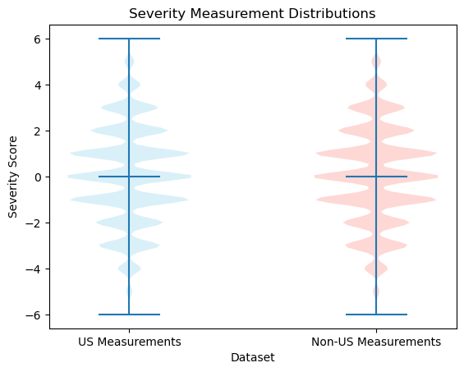
Question 5: US vs. Non-US Mental Health Violin plots of discrete data
The multiple violin plot shows the relative symmetry of the distributions, centered around 0.
The plots show very similar, nearly-normal shapes despite their failure of the normality tests.
The similar shapes of distribution mean the Mann-Whitney test will be testing for difference in pop. median

Slide 29
Question 5: US vs. Non-US Mental Health Normality tests
Both US and non-US populations failed the normality tests using scipy.stats.normaltest(). The low p-values for both populations suggests the underlying populations are not normally distributed.
US: test statistic = 776.82465918, p-value = 2.0638045e-169
Non-US - test statistic = 526.23257721, p-value = 5.37090858e-115
This suggests the inability to use many parametric statistical comparison tests in the comparison of this derived metric between US and non-US populations. However, due to the large sample sizes this limitation is ignored.

Slide 30
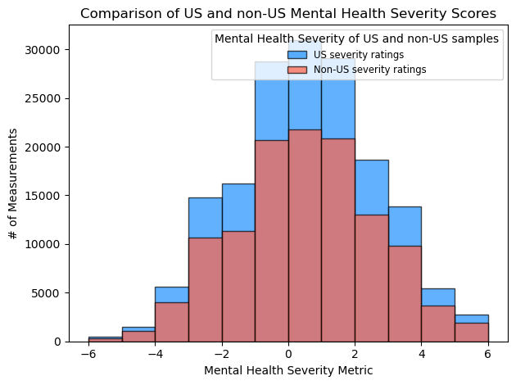
Question 5: US vs. Non-US Mental Health One-sided Mann-Whitney
A one-sided Mann-Whitney U-test was chosen due to -
the derived nature of the dependent variable (factor), as a composition of other underlying distributions
independence of both populations and observations
suggested non-normality of the underlying populations
the similar shape in distributions

Slide 31
Question 5: US vs. Non-US Mental Health One-sided Mann-Whitney U-test (cont.)
The Mann-Whitney test resulted in a p-value exceeding our a = 0.05 threshold. This means we fail to reject the null hypothesis, and conclude there is no statistically significant difference between median severity scores between US and non-US populations.
Test-statistic = 10042512229.5
P-value = 0.9431702048590704 > 0.05
Despite the inferred non-normality of the underlying distributions, a one-sided two-sample t-test was also conducted to check for a difference in mean, due to Central Limit Theorem.

Slide 32
Question 5: US vs. Non-US Mental Health One-sided two-sample t-test
The one-sided t-test resulted in a p-value exceeding our ɑ = 0.05 threshold. Although this test wasn’t initially chosen despite the non-normality and non-random samples, it was still performed due to the large sample sizes and the Central Limit Theorem.
Test-statistic = 1.6936521489831322
P-value = 0.9548337566013506 > 0.05
Since the p-value of the t-test exceeds 0.05, we fail to reject the null hypothesis and infer that there is no statistically significant indication that the mean severity of the US population is less than that of countries outside the US.

Slide 33
Question 5: US vs. Non-US Mental Health Results and Improvements
The non-normality of the underlying distributions of our derived mental health severity factor promoted the use of a nonparametric test. However, due to the large sample sizes, a parametric test was also performed. Both tests were performed at 95% confidence, with ɑ = 0.05.
Mann-Whitney U-test - No significant indication that median severity of mental health is lower in the United States.
Two-sample t-test - No significant indication that mean mental health severity is lower in the United States.
Neither test revealed a lower average mental health score in the US than in countries outside the US. Limitations of this analysis include -
The initial data may not have been collected randomly (voluntary survey data)
The factor analyzed was a linear combination of existing factors, whose underlying distributions were not known
Countries like the US, UK, and Canada had much larger datasets than the other 32 countries
Nonparametric statistics can limit the conclusions drawn from results

Slide 34
Question 6
How impactful is family history on mental health and can it be proven genetics impacts mental health outcomes more than the environment?

Slide 35


Slide 36
Question 6: Does a Family History of Mental Health increase the likelihood of being treated?
Null Hypothesis: There is no increase in seeking treatment for mental health with a family history of mental health.
Alternative Hypothesis: There is an increase in seeking treatment for mental health with a family history of mental health.

Slide 37
Order of Operations
refine data frame to target correlation between family history and treatment scores (yes[1]/no[-1])
find critical variables with high variance that can contribute to the sensitivity of the data
keep important columns around family history and treatment scores
test for data integrity

Slide 38
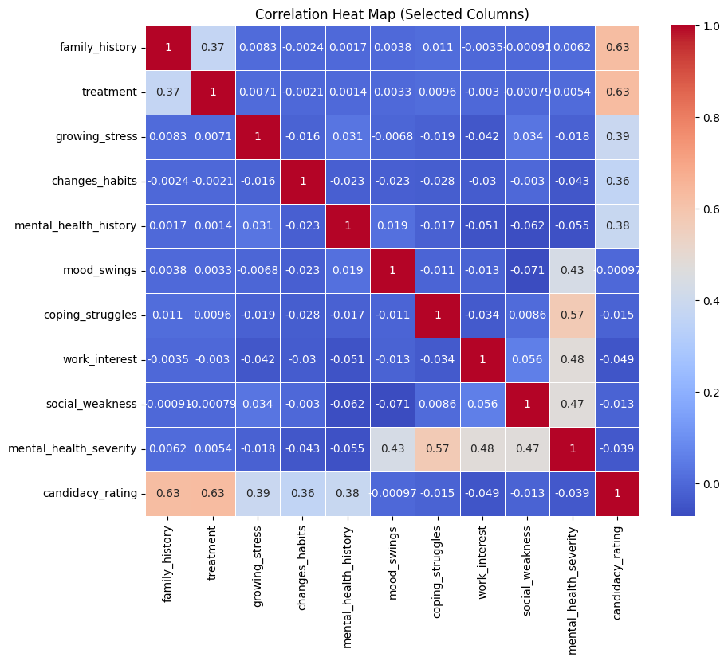
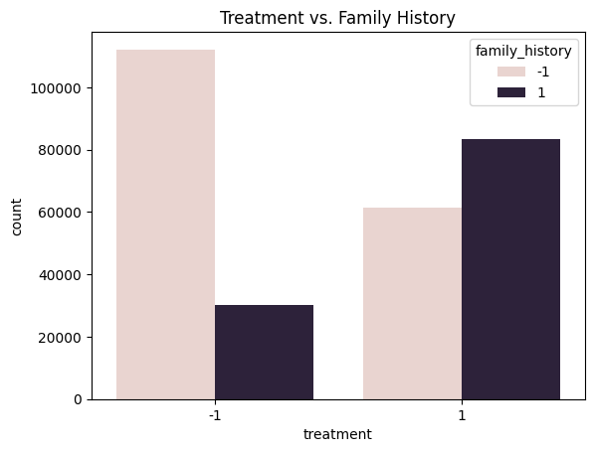
statistic tests
treatment vs. family history
P-value < 0.5
chi squared 39,624

Slide 39
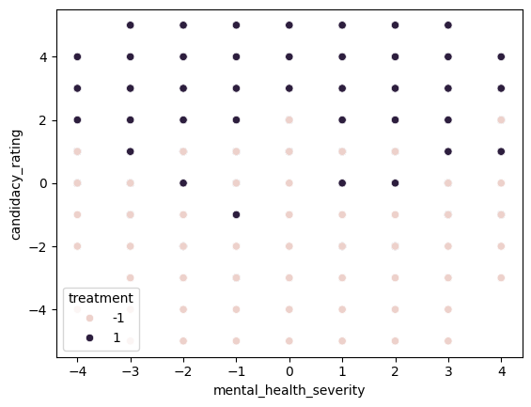
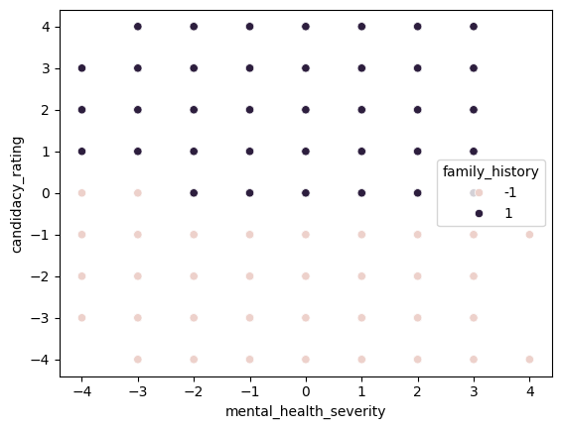
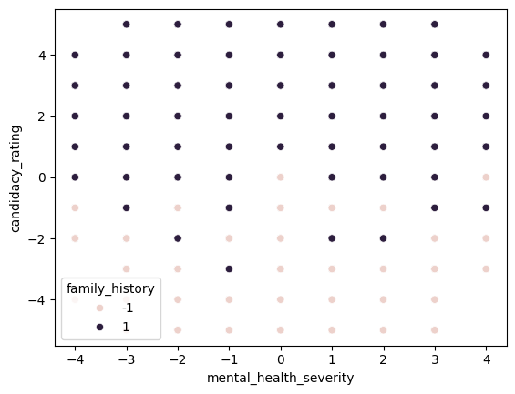
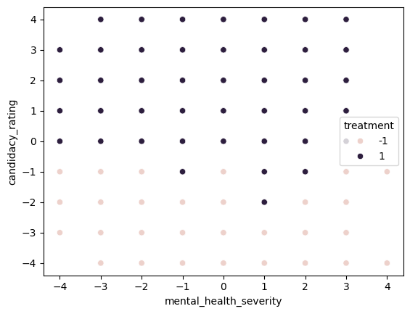
before -> after
data refining around the main features:
severity and candidacy rating
Notes:
after dropping columns, there is a cleaner division across mapping candidacy rating and mental health severity for both family history and treatment

Slide 40
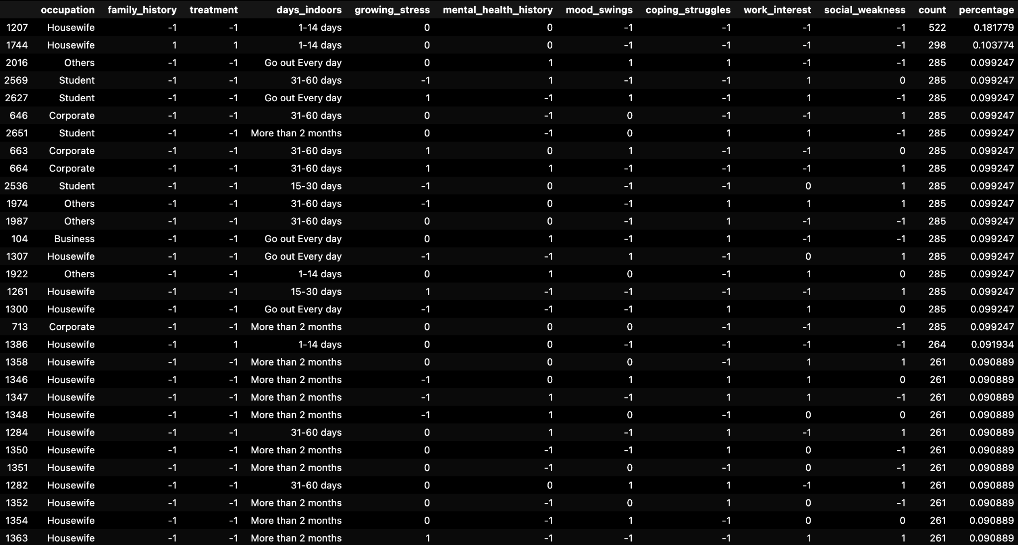

Slide 41

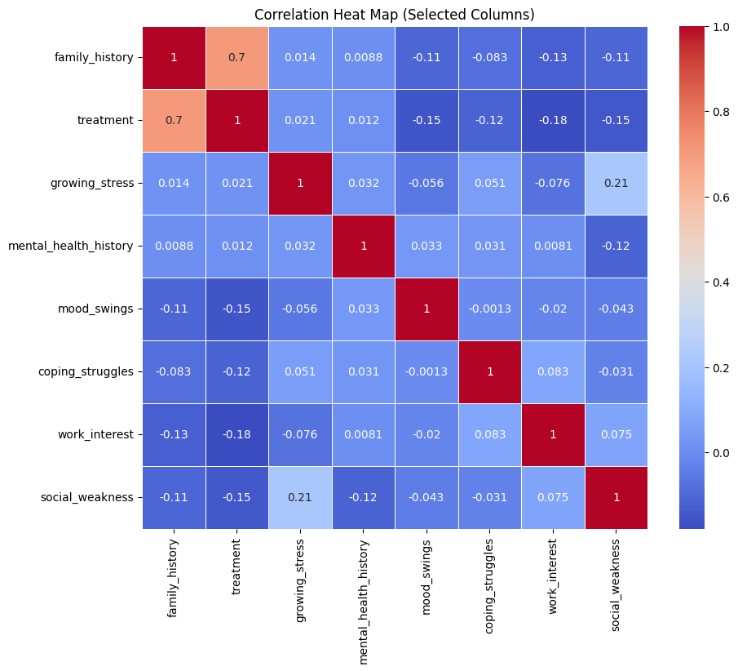
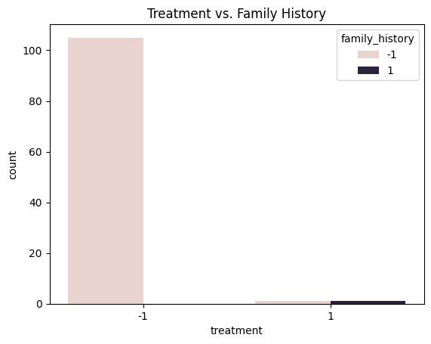
mental trait- sum top 10 percent
chi-squared = 12.748
p-value = 0.00056
Notes:
medium chi squared represents predictability, pvalue shows that null can be rejected

Slide 42
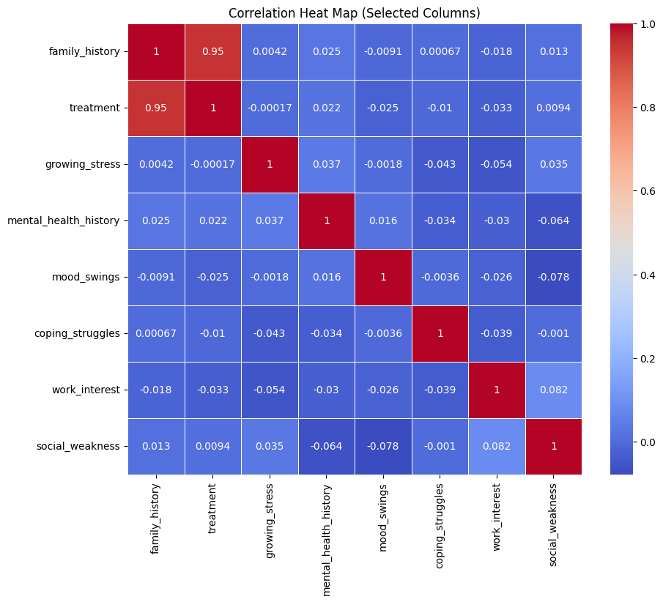
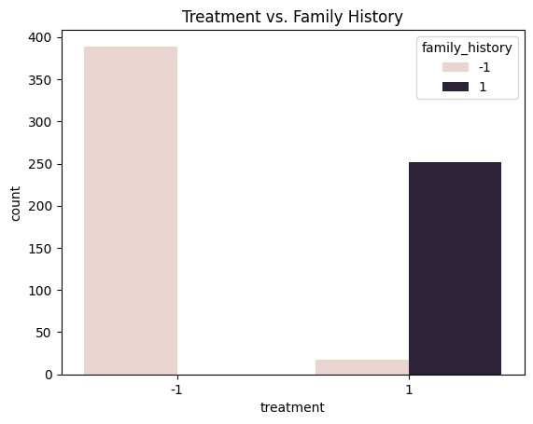
mental trait - sum top 50 percent
chi squared = 586.648
p-value = 0.00
Notes:
data keeps its integrity

Slide 43

Family History and Treatment are Highly Correlated
summary -
analyze mental traits that can be studied for genetic similarities by weighting and ranking the results in order of popularity
encourage further study by “classifying” a normal population that are grouped by mental traits
these specific subjects are chosen for the next trial where genetic testing would be implemented

Slide 44
Summary of Major Finding & Conclusions
These results suggest that any observed differences in mental health history between genders are due to random chance or other factors.
Self-employed are less susceptible to mental health issues
Q5: There is no significant difference between mental health severity in the US vs. among non-US countries.
Family History and Treatment are highly correlated
Recommendation:
Employers (private or public) should have make care options more available to employees. It could include professional therapy, counseling, psychiatric care, support groups, or other forms of mental health support.

Slide 45
Q & A

Slide 46
BACK UP MATERIAL

Slide 47
Data
Survey Results https://www.kaggle.com/datasets/bhavikjikadara/mental-health-dataset/data
independent variables |  | Grading
gender | Respondent gender
country | Respondent country
occupation | Respondent occupation
treatment | Have you sought treatment for a mental health condition? | Yes = 1, No = - 1, Maybe = 0
self employment | Are you self-employed or not?
family history | Do you have a family history of mental illness? | Yes = 1, No = - 1, Maybe = 0
days indoors | Respondent # of days spent indoors
growing stress | increase in stress levels experienced by individuals over time | Yes = 1, No = - 1, Maybe = 0
changes habits | alterations in daily routines or behaviors that individuals adopt in response to mental health issues. It could include changes in sleep patterns, eating habits, exercise routines, or other lifestyle adjustments. | Yes = 1, No = - 1, Maybe = 0
coping struggles | difficulties or challenges individuals face in managing or coping with stress, emotions, or mental health issues | Yes = 1, No = - 1, Maybe = 0
work interest | n individual's level of interest or motivation in their work or occupational activities | Yes = -1, No = 1, Maybe = 0
social weakness | difficulties or challenges in social interactions or relationships, possibly indicating social anxiety, interpersonal conflicts, or a lack of social support. | Yes = 1, No = - 1, Maybe = 0
care options | availability or choices of mental health care services or treatment options that individuals have access to | Yes = 1, No = - 1, Maybe = 0
mental health interview | a structured or semi-structured interview conducted to assess various aspects of an individual's mental health
mood swings | fluctuations or changes in an individual's emotional state | Low -1 Medium 0 High 1

Slide 48
Data Clean Up
Removed Time Stamp from original data set
created addition features to compound variables for a larger effect
Removed null values
Assigned numerics to yes/no values
Notes:
dumping in data description info
key info

Slide 49
Grading Requirements
Completed Analysis Uploaded to GitHub (20 points)
Final data analysis contains ample and complete information in README file (10 points)
Final repository is acceptable for professional quality presentation (10 points)
Visualizations (20 points)
6–8 visualizations of data (at least two per question) (10 points)
Clear and accurate labeling of images (5 points)
Visualizations supported with ample and precise explanation (5 points)
Analysis and Conclusion (20 points)
Write-up summarizes major findings and implications at a professional level (5 points)
Each question in the project proposal is answered with precise descriptions and findings (5 points)
Findings are strongly supported with numbers and visualizations (5 points)
Each question response is supported with a well-discerned statistical analysis from lessons (e.g., aggregation, correlation, comparison, summary statistics, sentiment analysis, and time series analysis) (5 points)
Group Presentation (20 points)
All group members spoke during the presentation (5 points)
Group was well prepared (5 points)
Presentation is relevant to material (5 points)
Presentation maintains audience interest (5 points)
Slide Deck (20 points)
Slides are visually clean and professional (5 points)
Slides are relevant to material (5 points)
Slides effectively demonstrate the project (5 points)
Slides are clear and maintain audience interest (5 points)

Slide 50
Quick Access to Repository &
Google Docs
GitHub Repository
README
Noteboo(k)
CSV
Google Docs
Proposal
Task Plan
Other

Slide 51
THANK YOU
Jean - <email or LinkedIn link >
Grant <email or LinkedIn link >
Naveen <email or LinkedIn link >
Rose Mary Rios <email or LinkedIn link >
Ryan <email or LinkedIn link >

